Slide 1
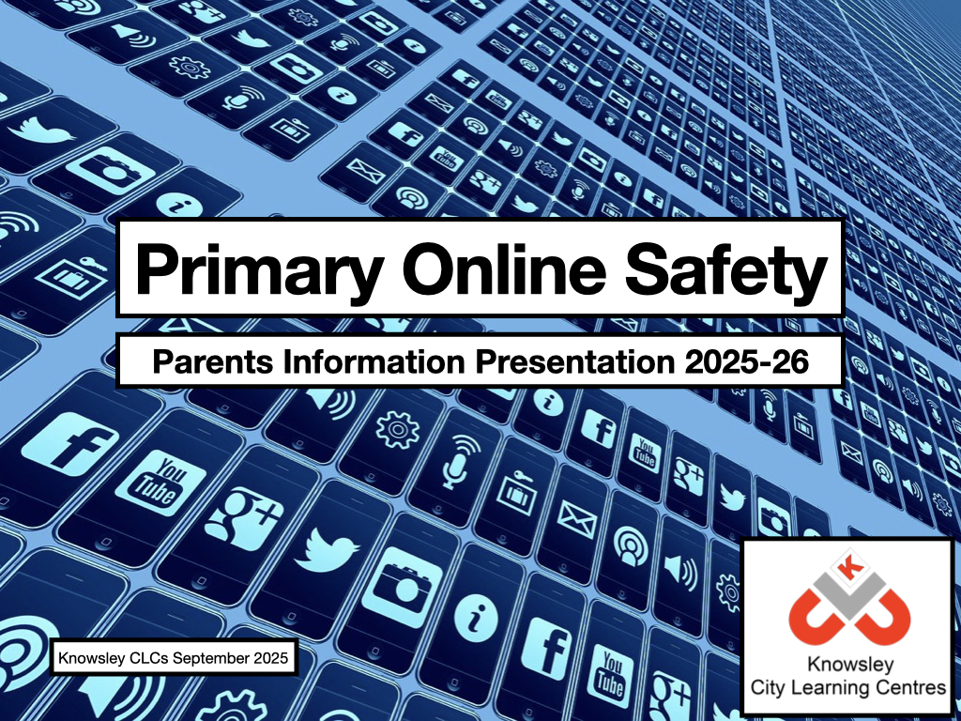

Slide 2
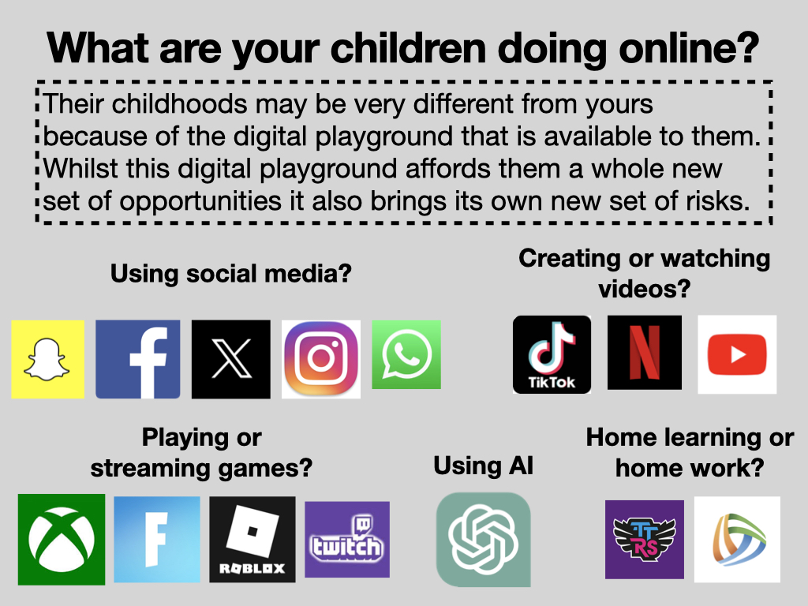

Slide 3
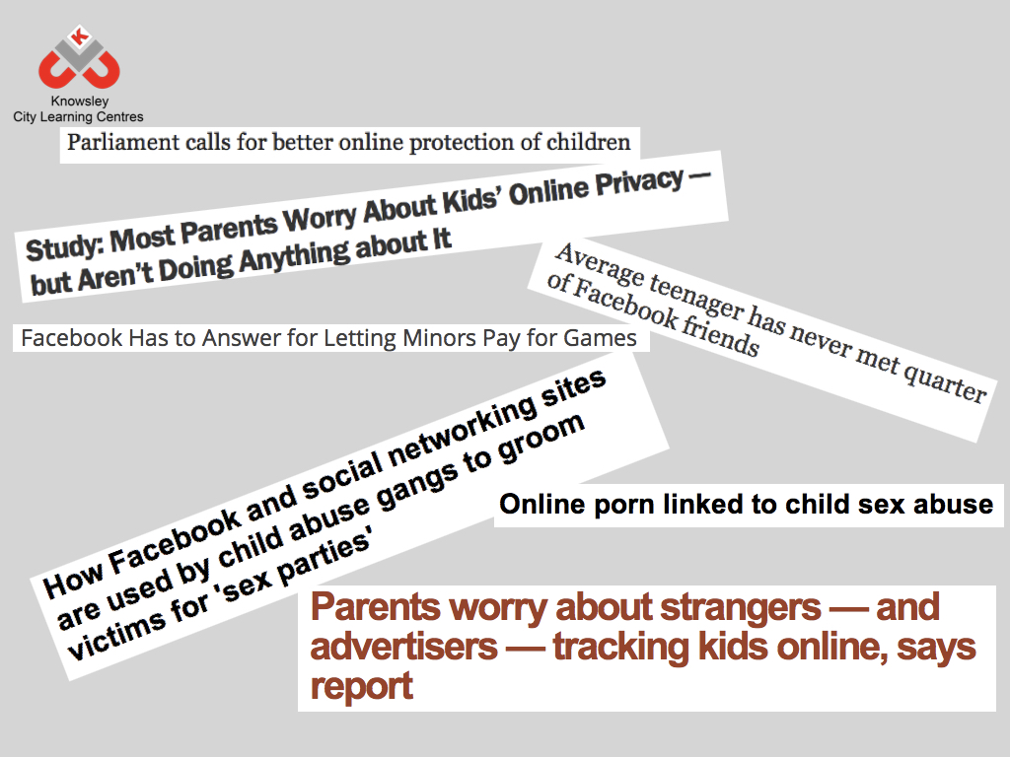

Slide 4
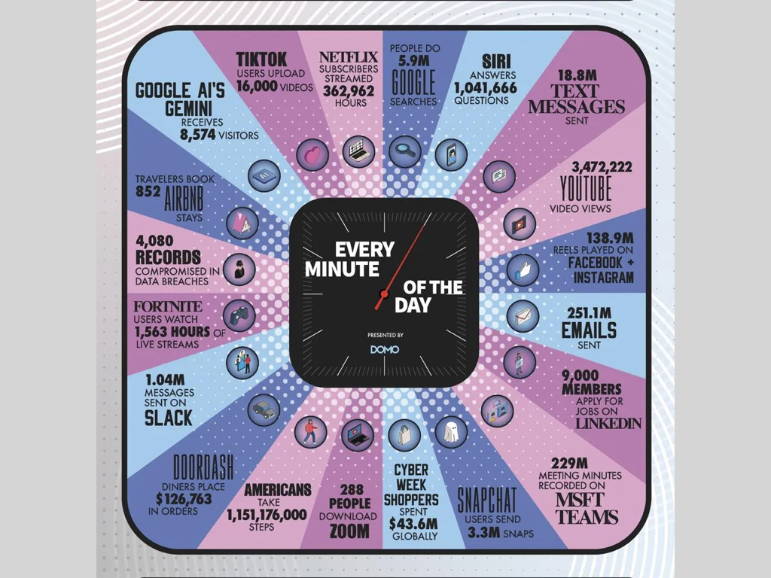

Slide 5
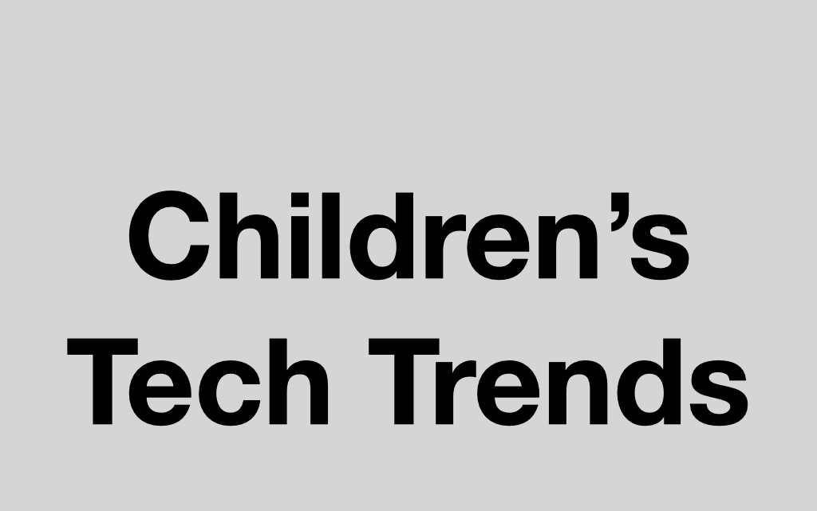
Ofcom children’s media use and attitudes report
https://www.ofcom.org.uk/siteassets/resources/documents/research-and-data/media-literacy-research/children/childrens-media-use-and-attitudes-report-2025/childrens-media-literacy-report-2025.pdf?v=396621
Internet Matters: wellbeing in a digital world 2025
https://www.internetmatters.org/hub/research/childrens-wellbeing-in-a-digital-world-index-report-2025/

Slide 6
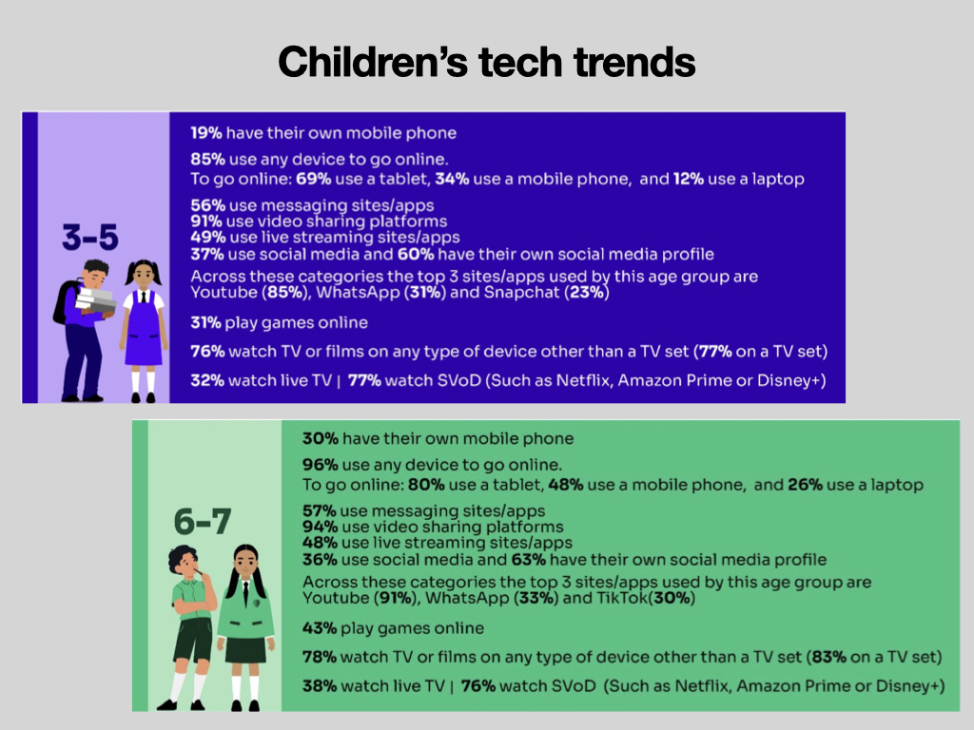

Slide 7
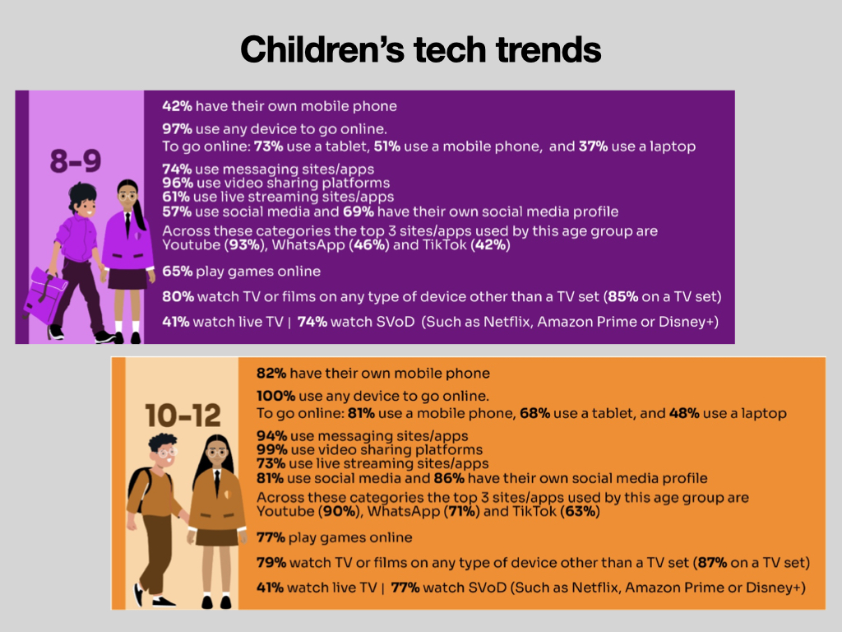

Slide 8
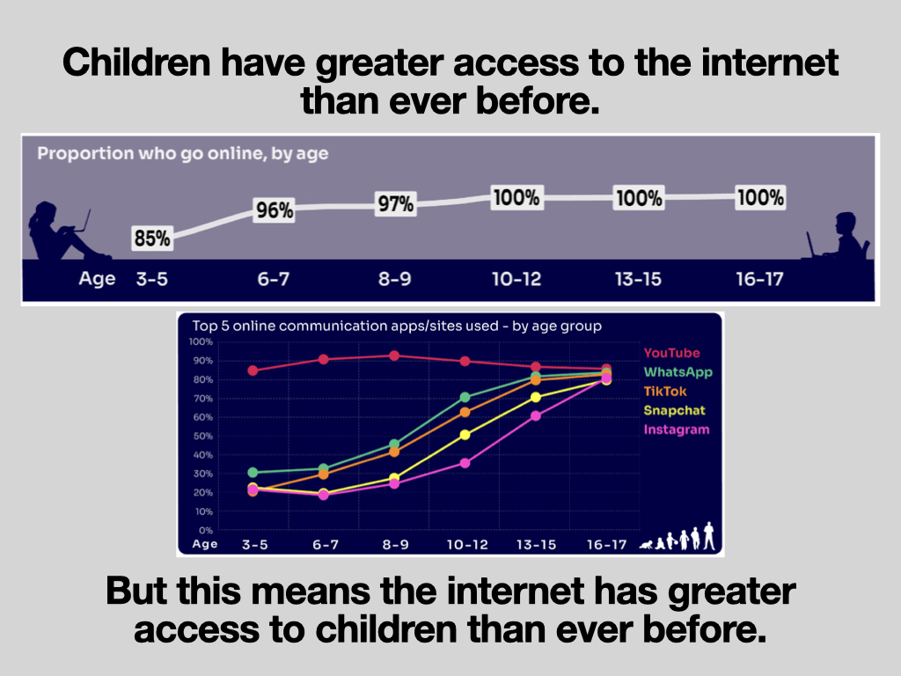

Slide 9
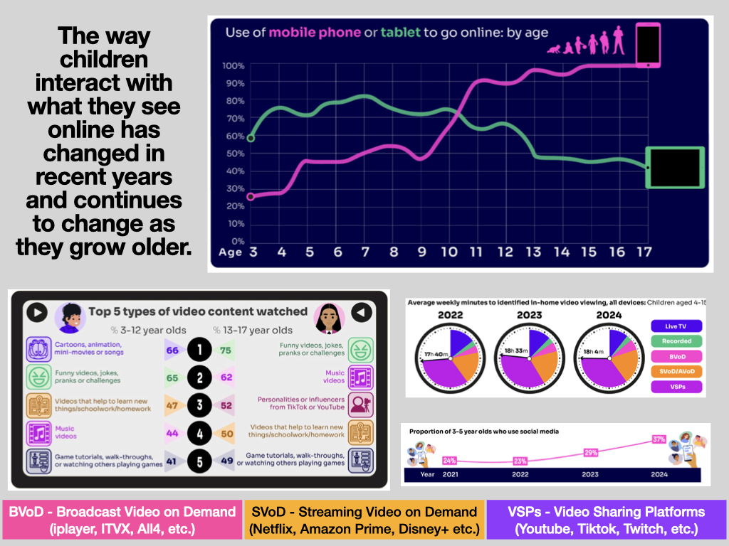

Slide 10
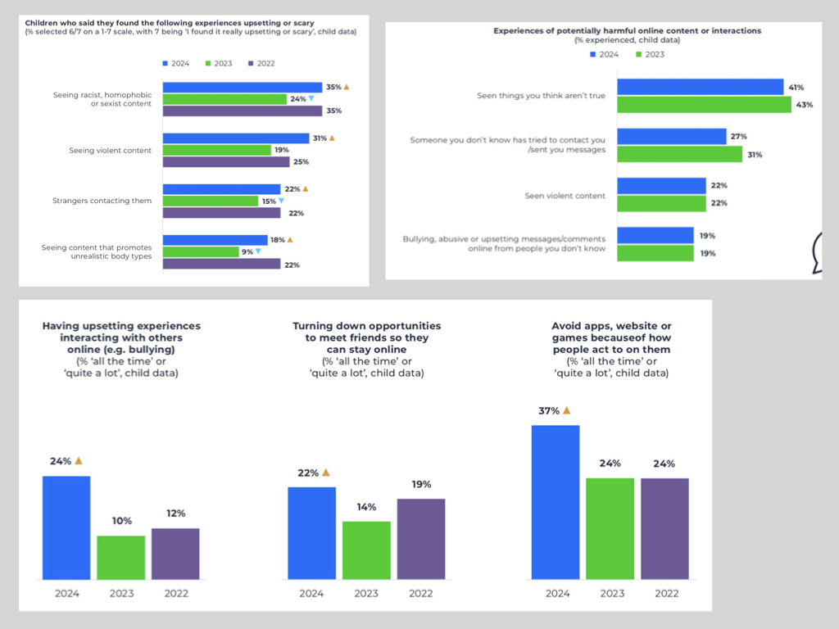

Slide 11
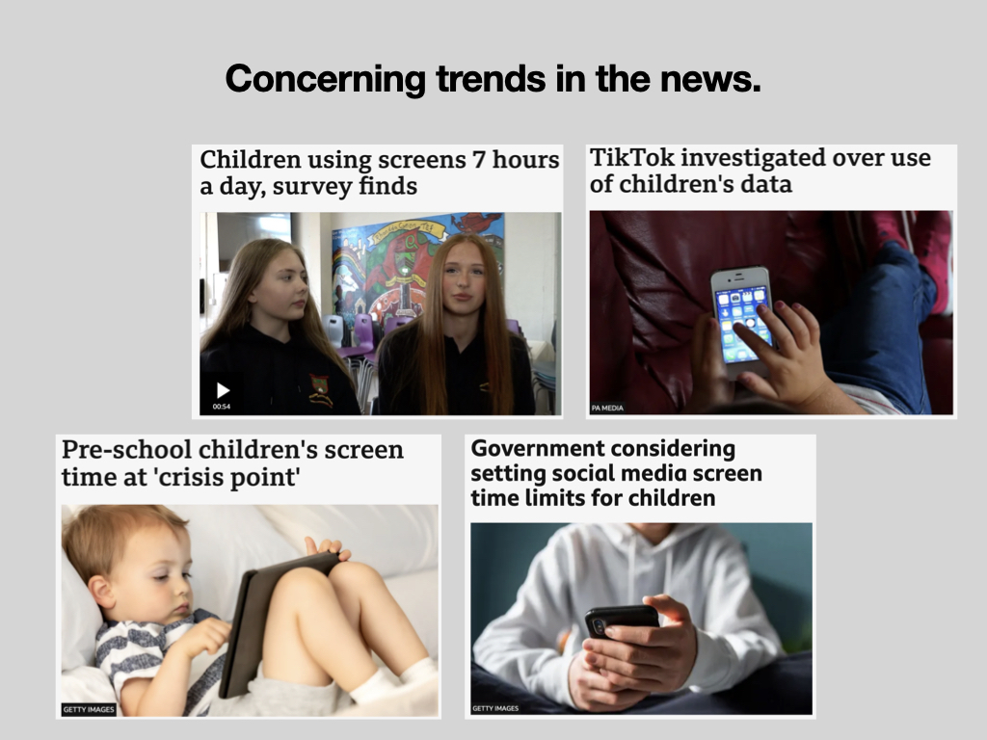

Slide 12
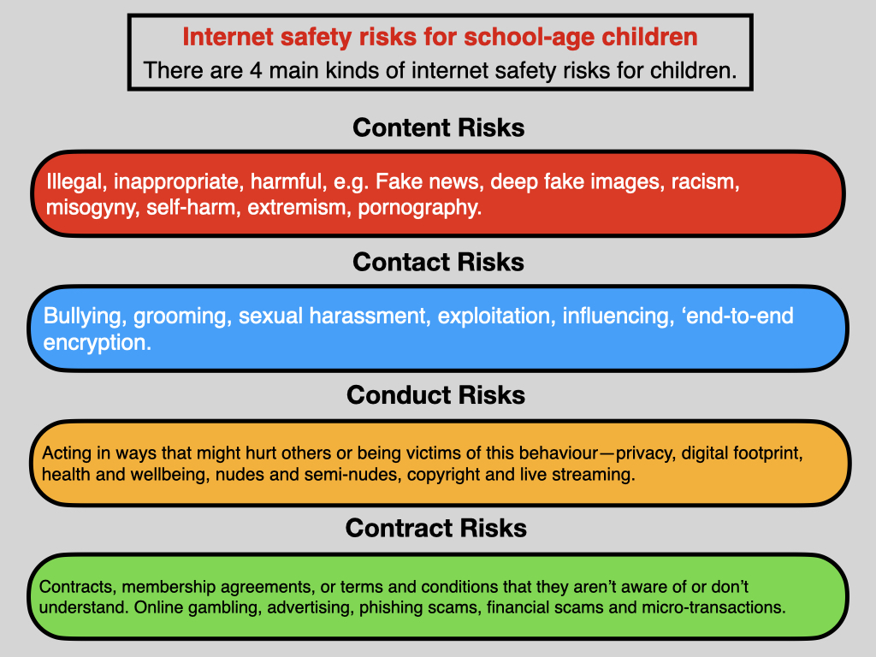

Slide 13


Slide 14
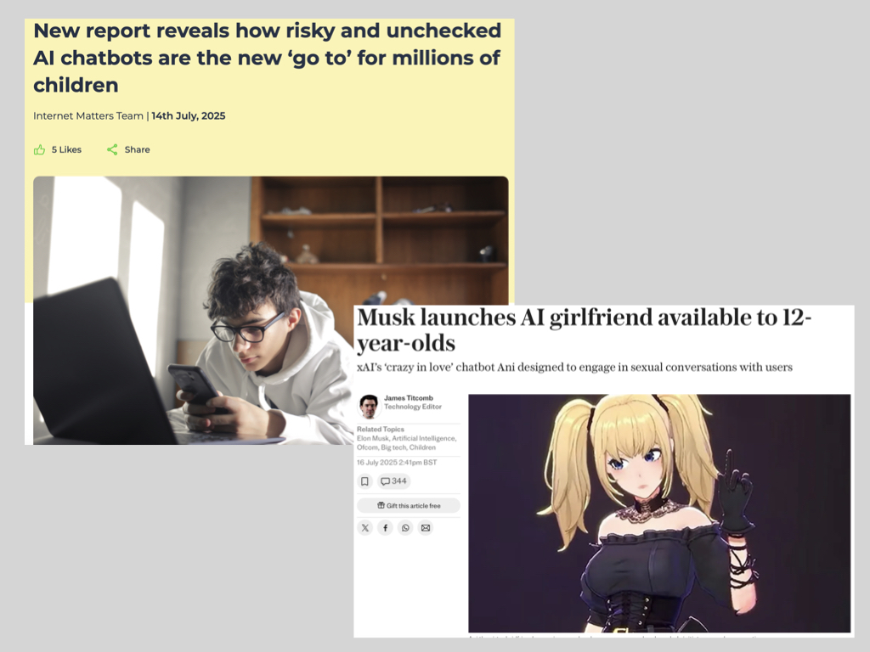

Slide 15
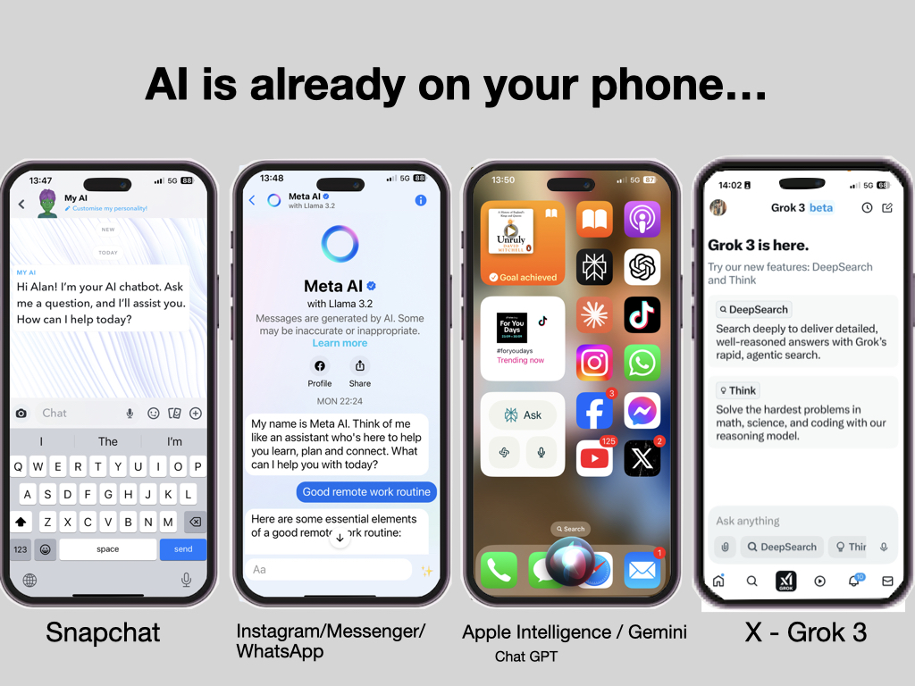

Slide 16
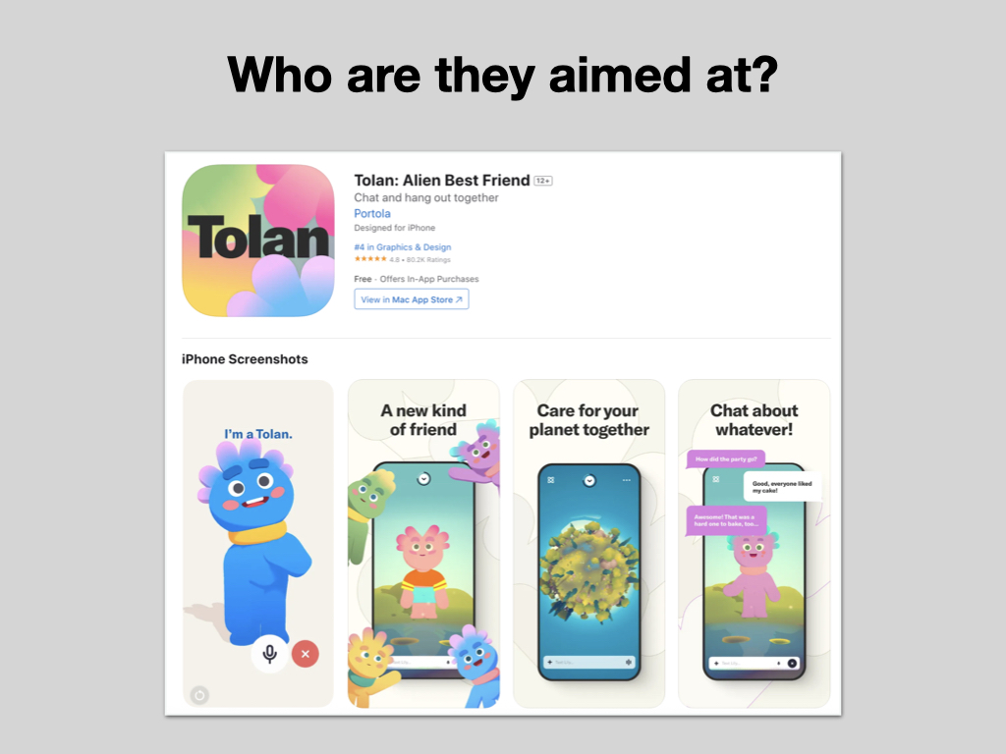

Slide 17
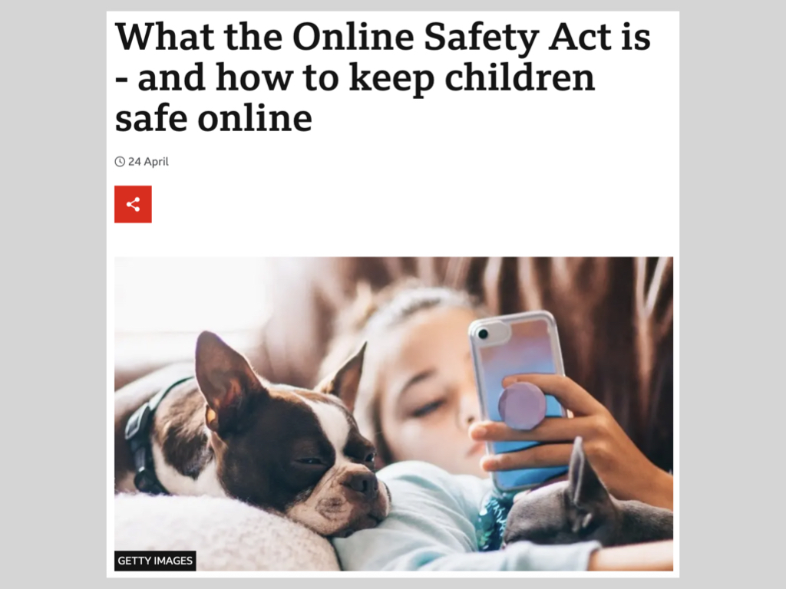

Slide 18
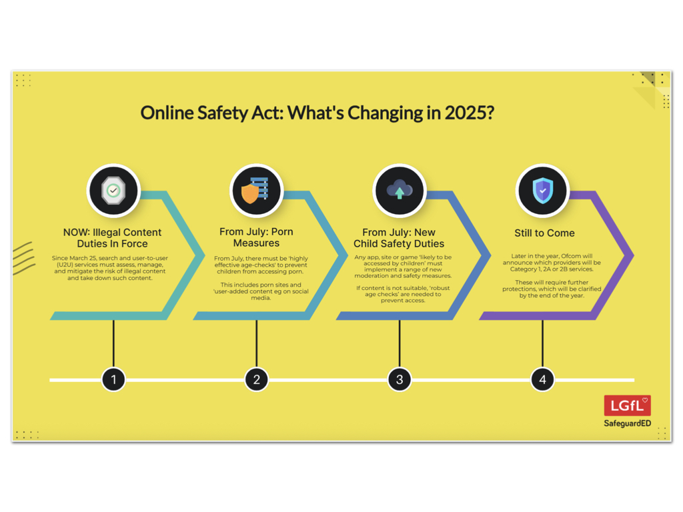

Slide 19
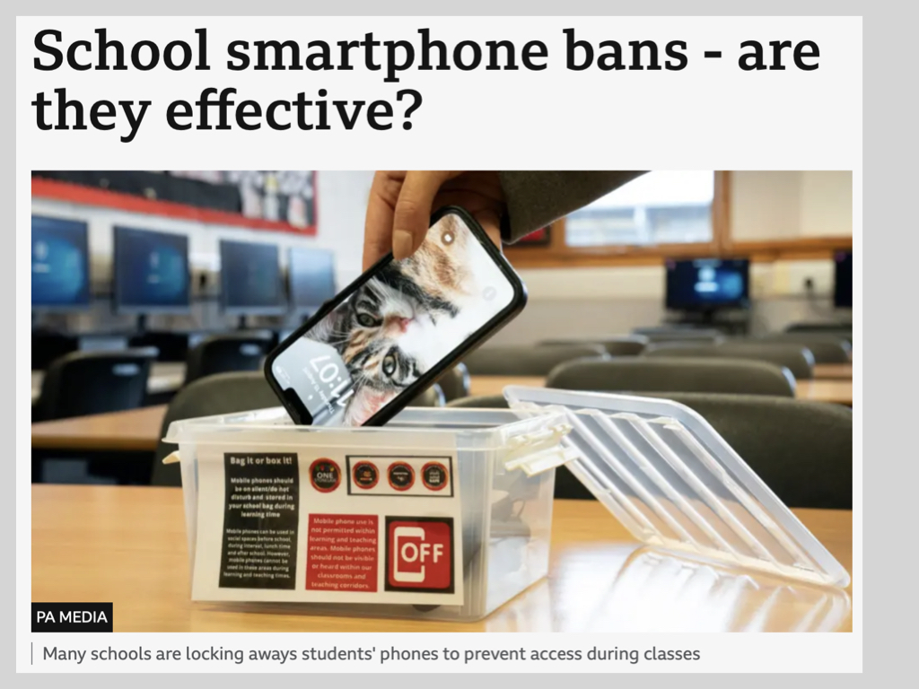

Slide 20


Slide 21
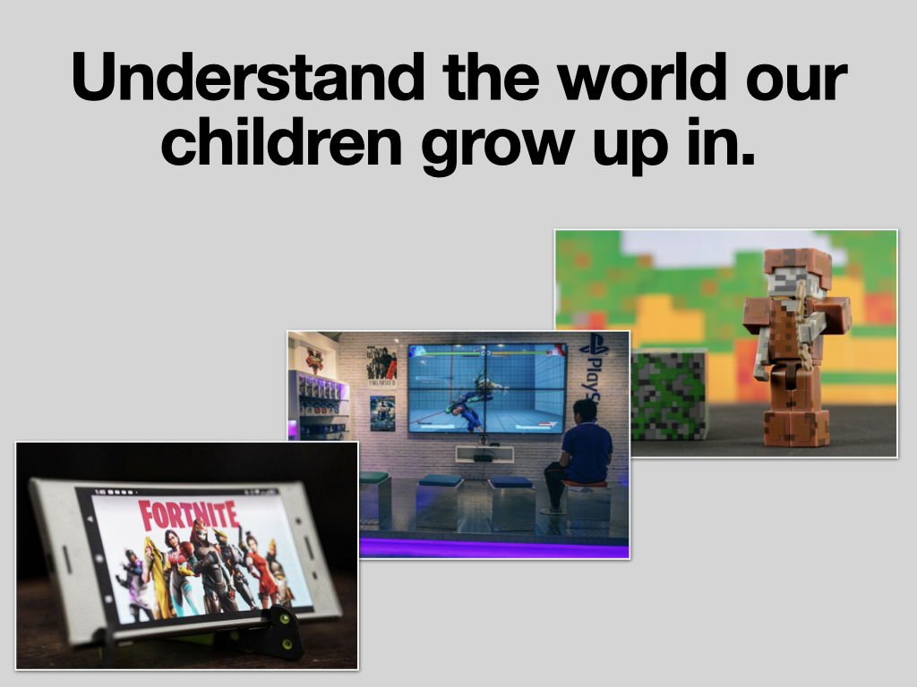

Slide 22
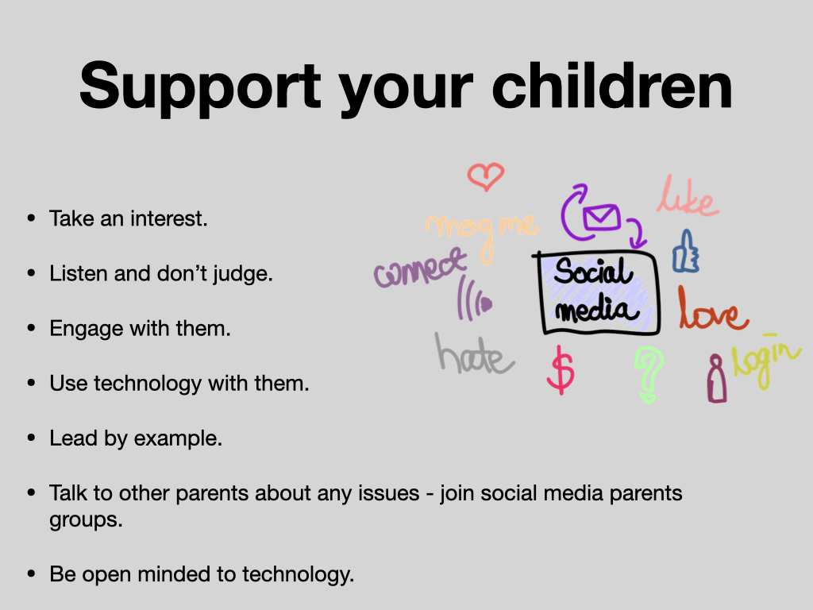

Slide 23
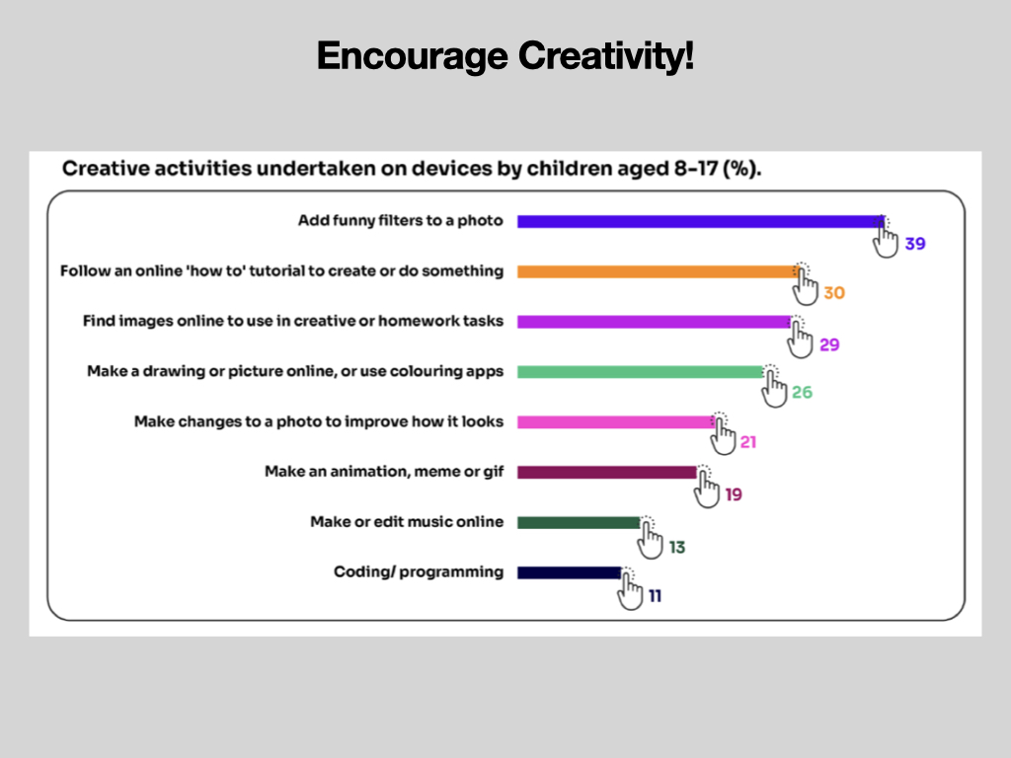

Slide 24
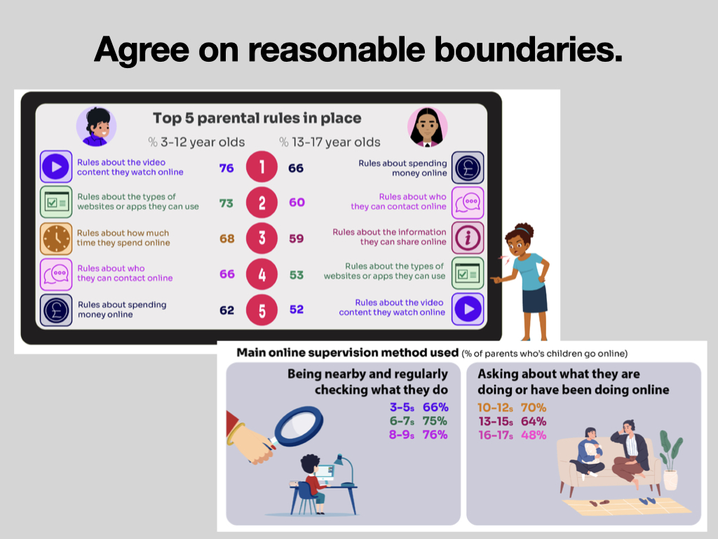

Slide 25
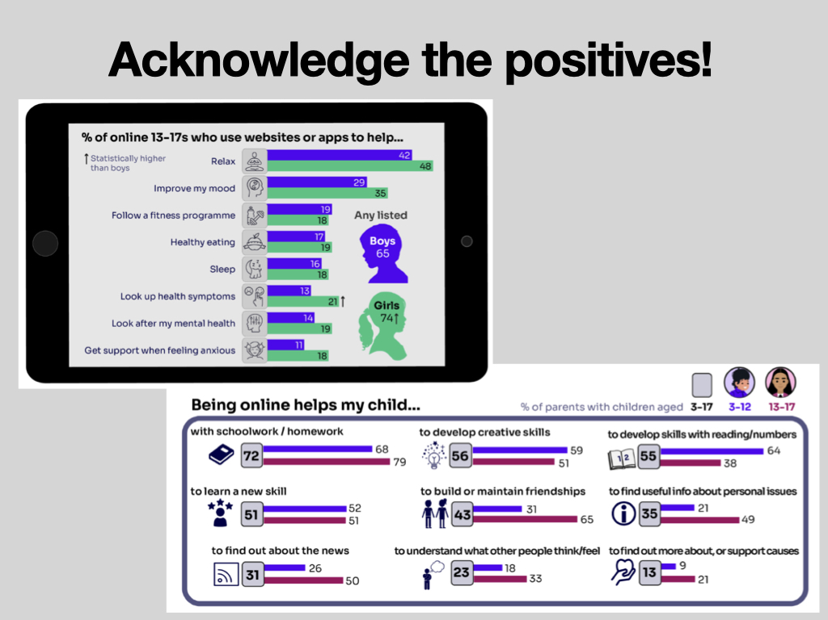

Slide 26
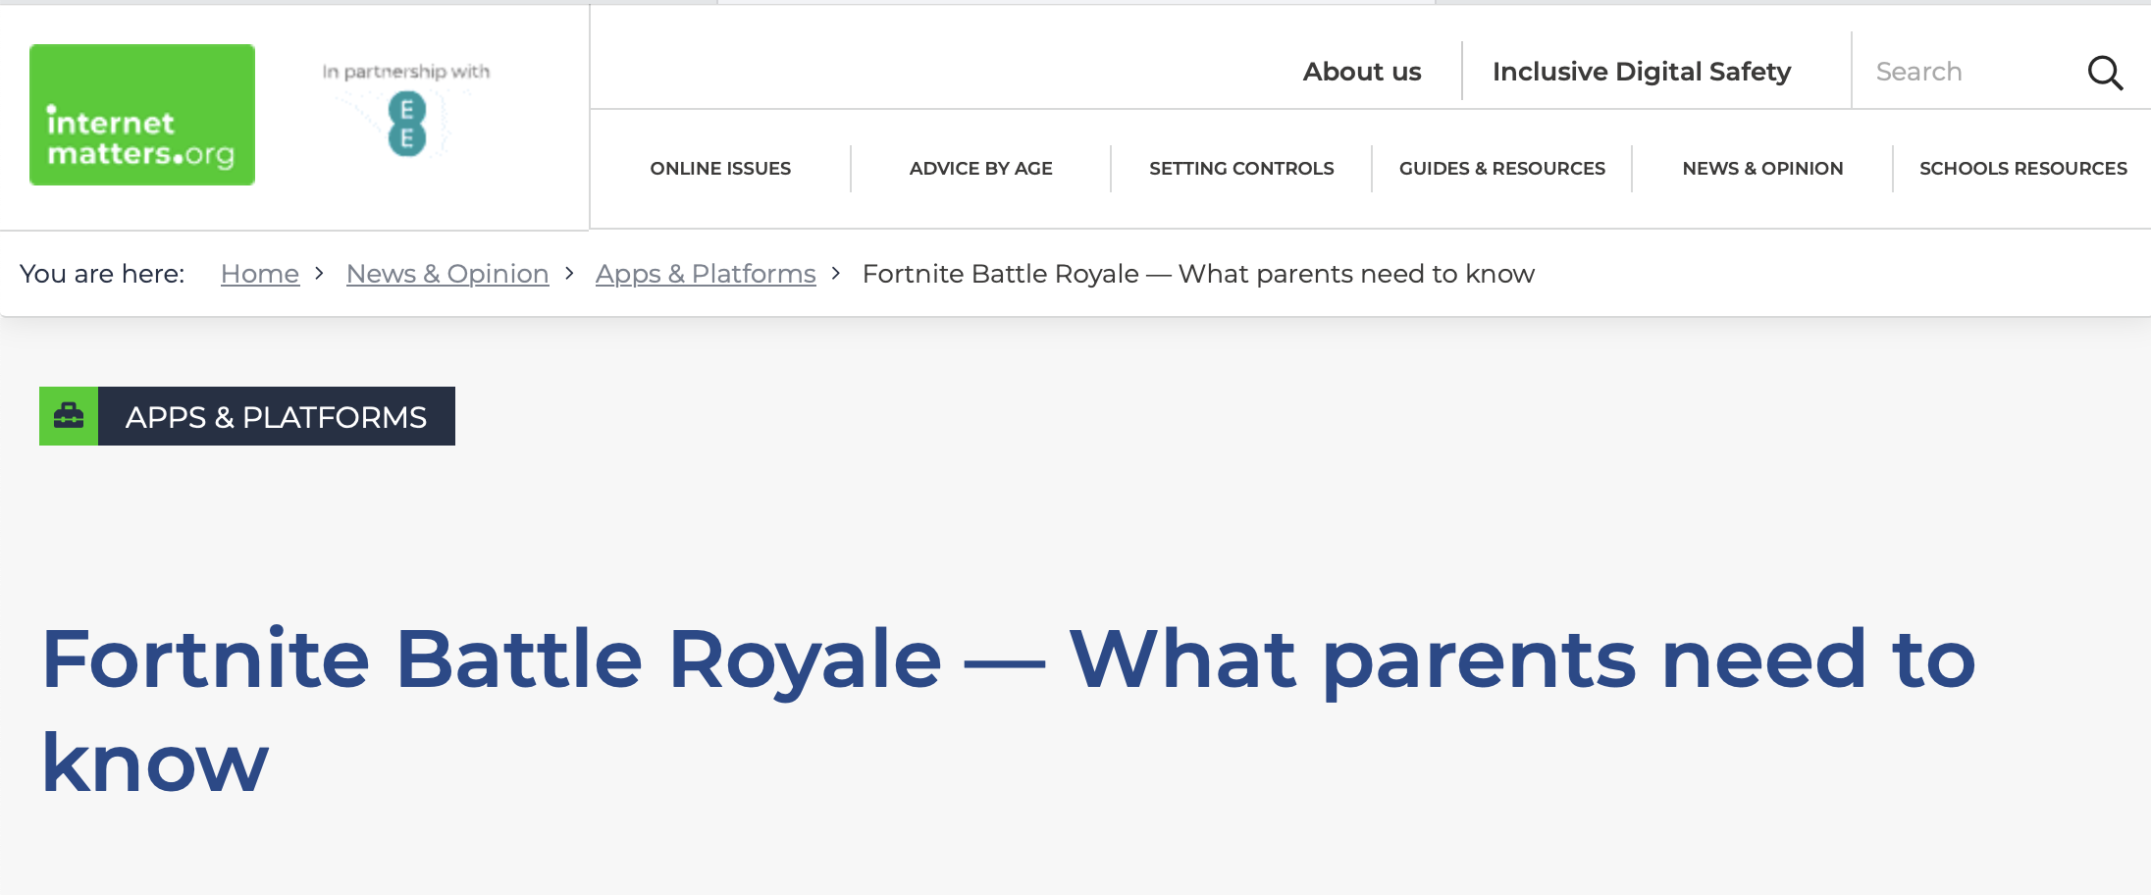

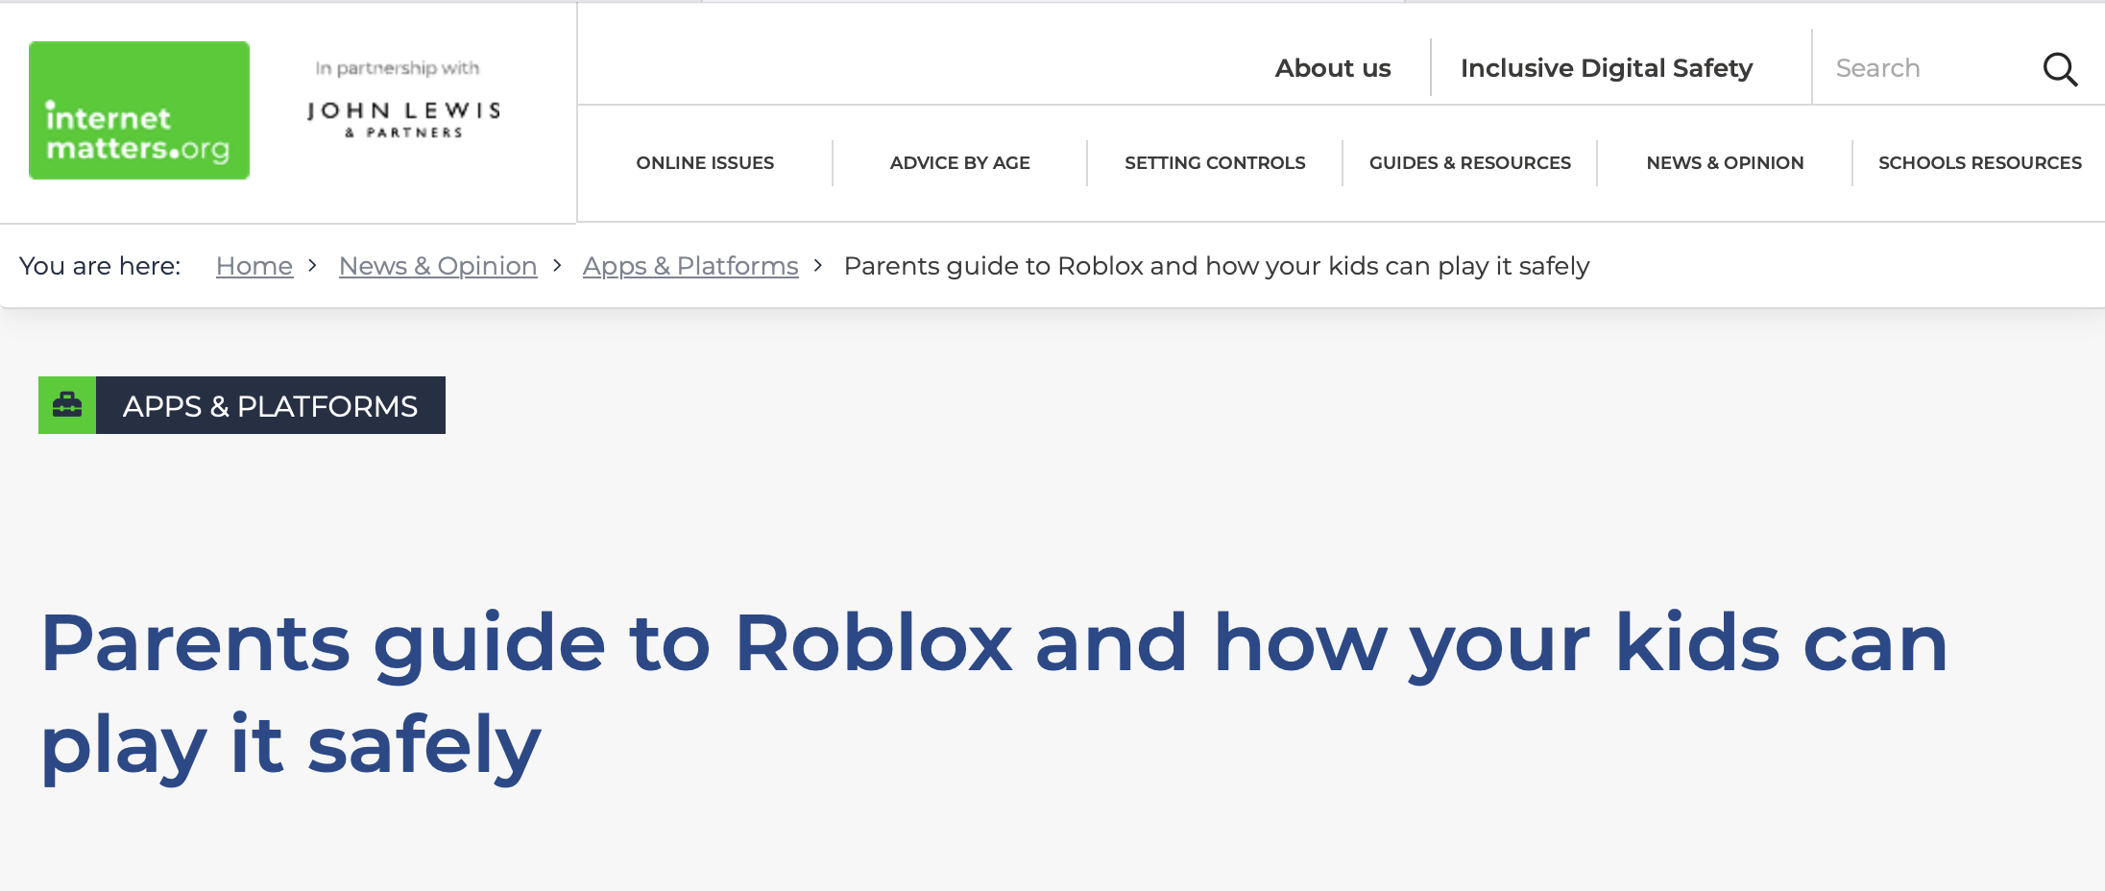
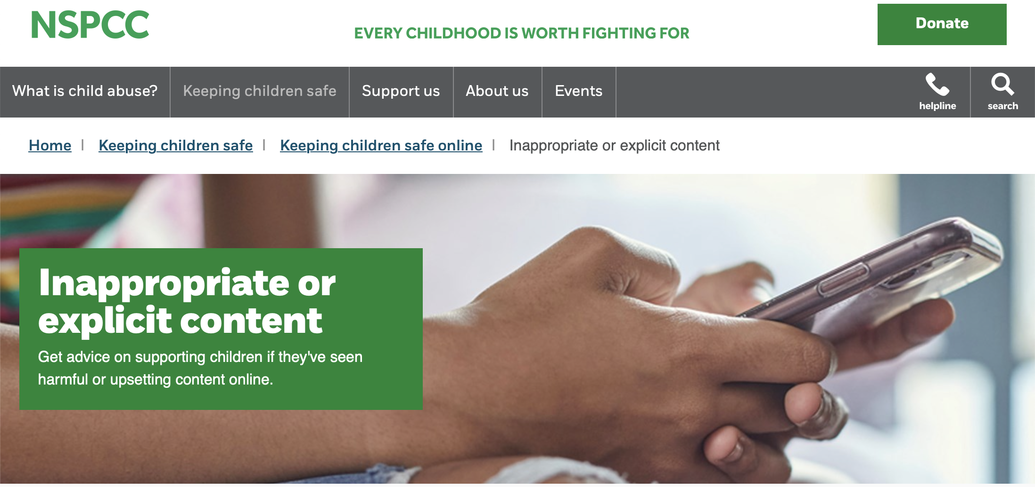
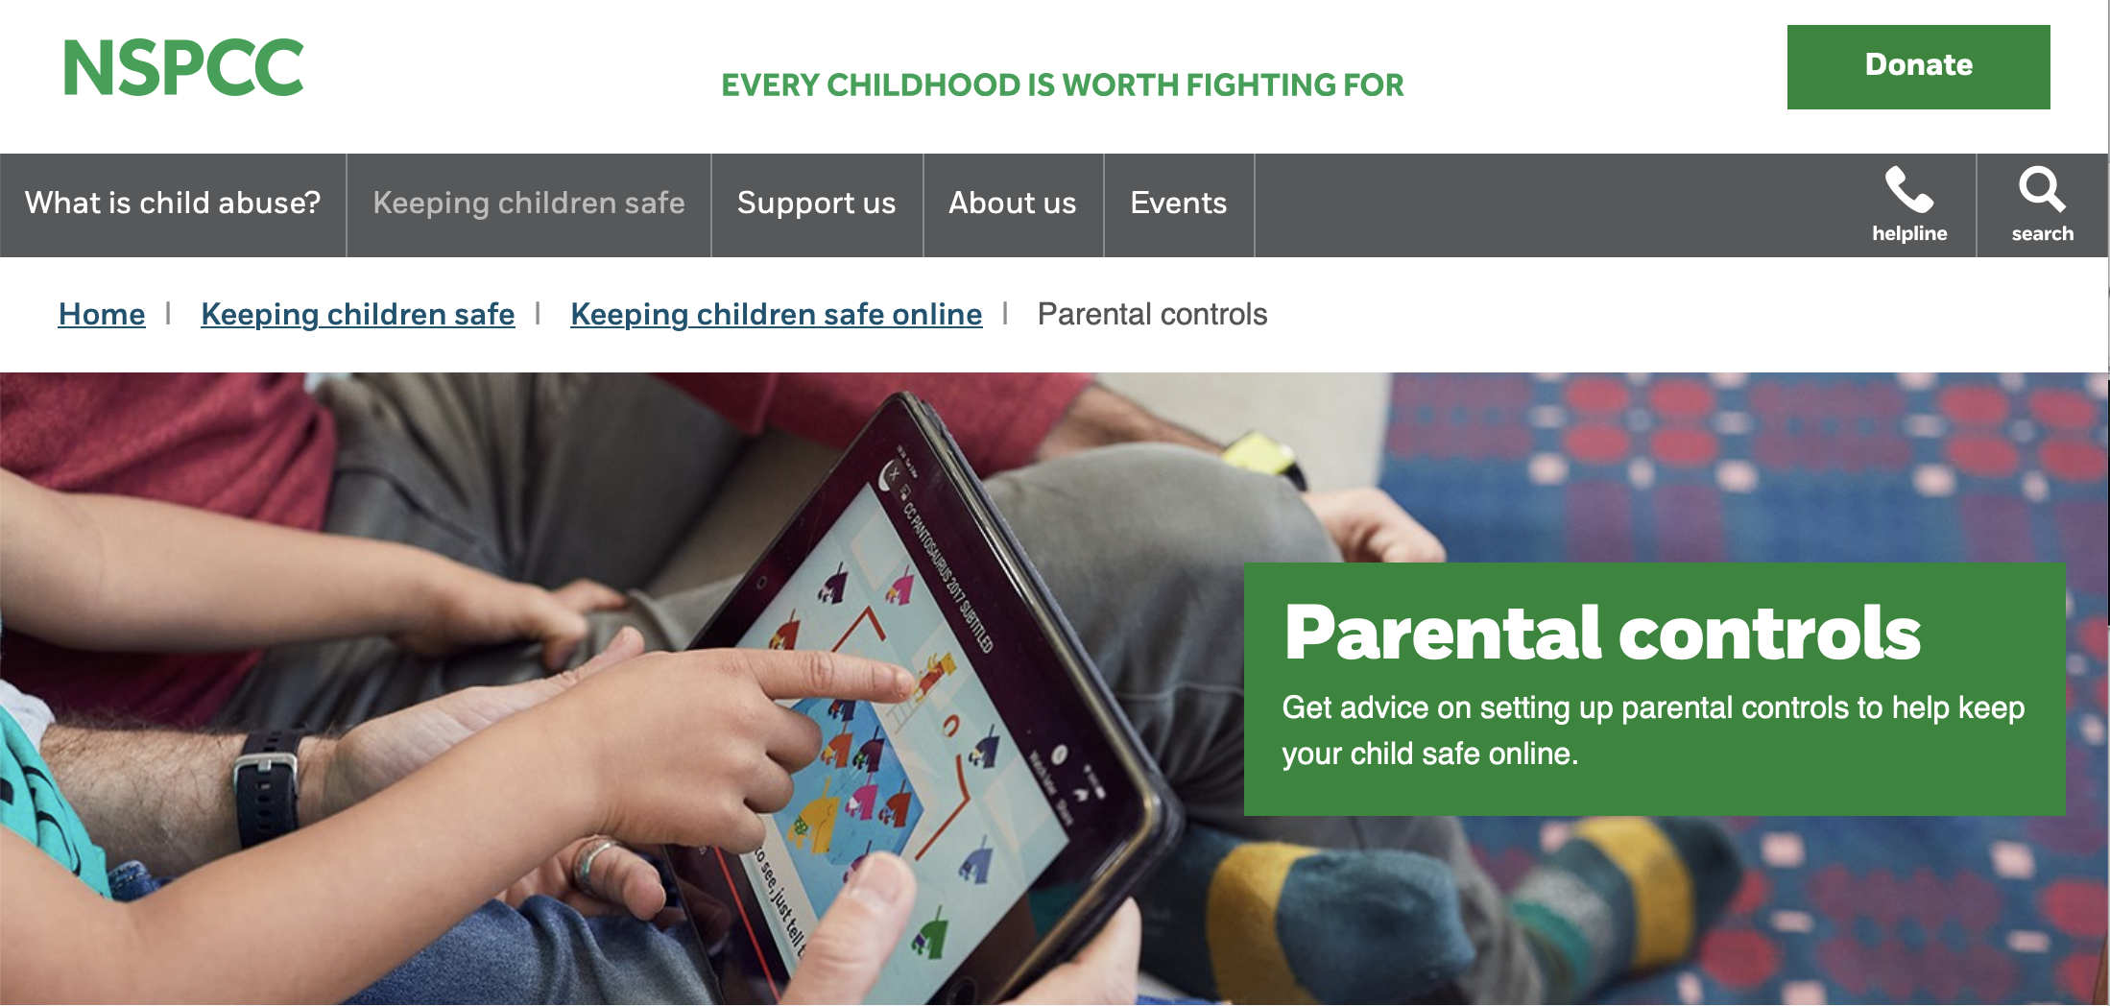

Be Knowledgeable
https://www.internetmatters.org/
https://www.nspcc.org.uk/keeping-children-safe/online-safety

Slide 27
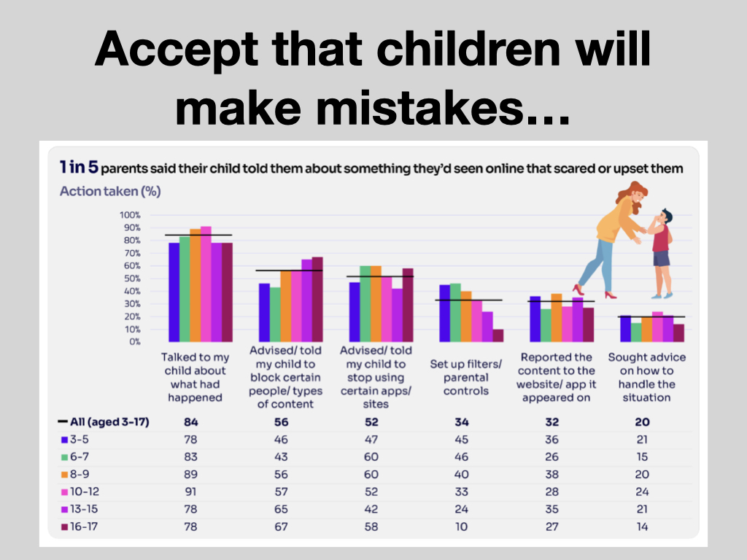

Slide 28
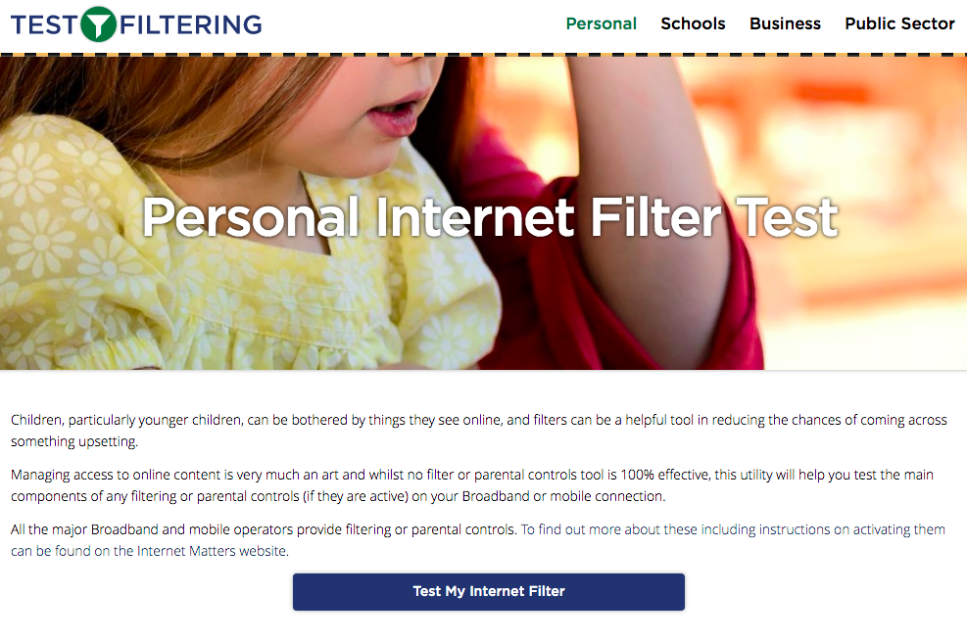
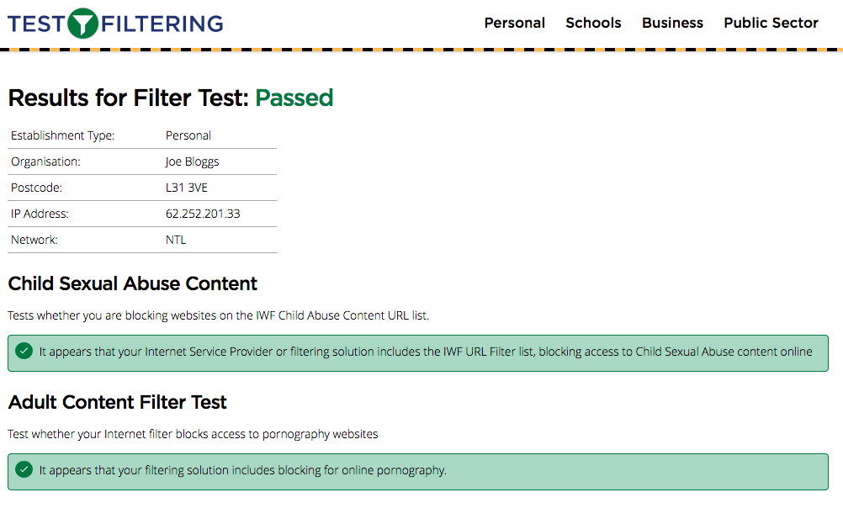
Test your home filtering
http://testfiltering.com/

Slide 29


Slide 30
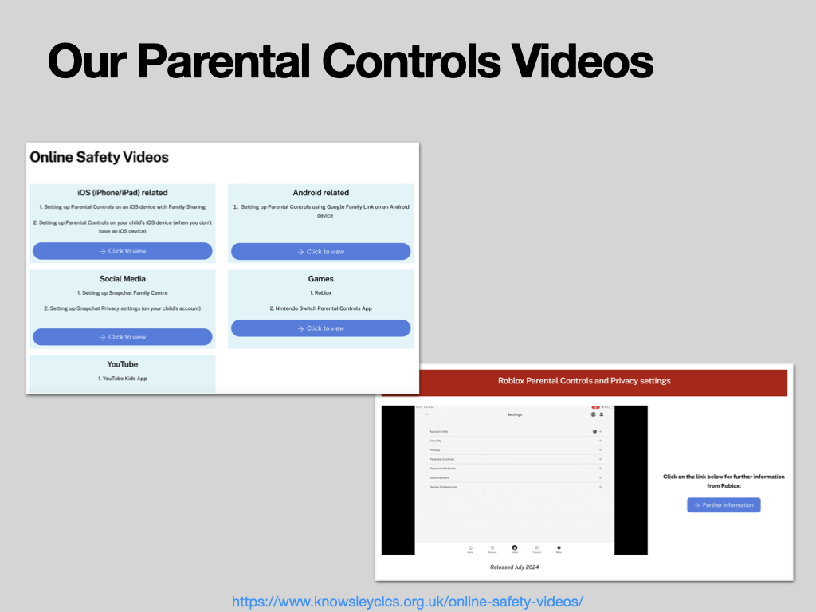
https://www.knowsleyclcs.org.uk/online-safety-videos/

Slide 31
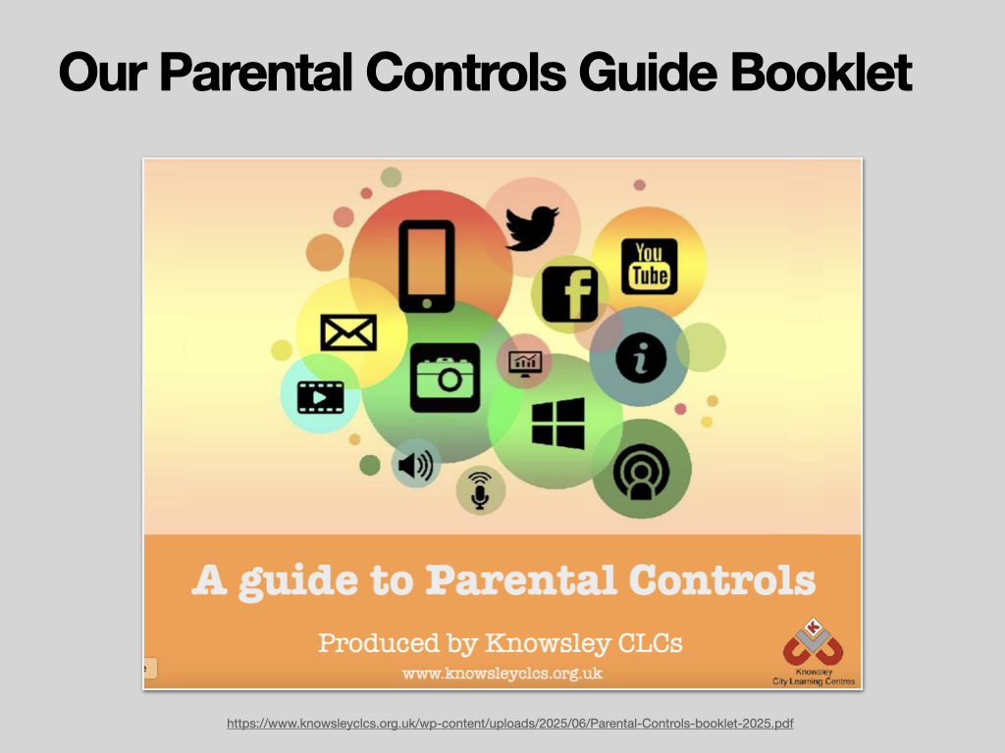
https://www.knowsleyclcs.org.uk/wp-content/uploads/2025/06/Parental-Controls-booklet-2025.pdf

Slide 32
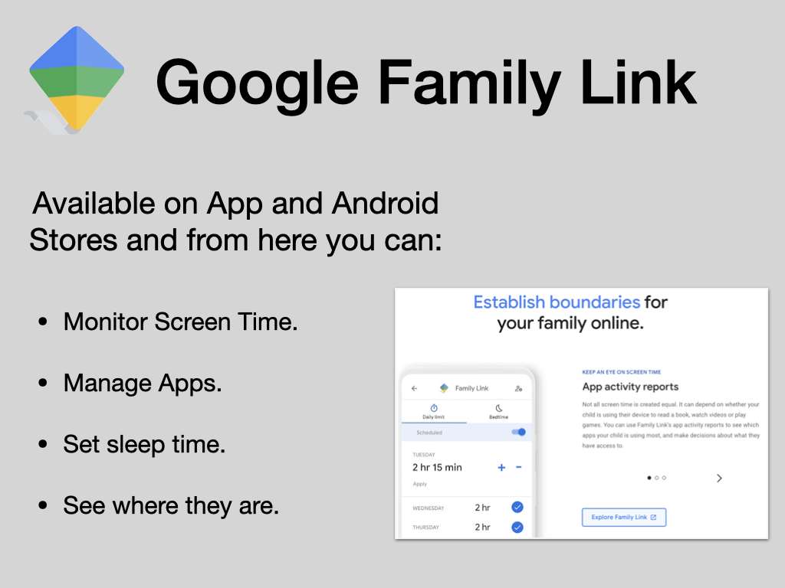

Slide 33
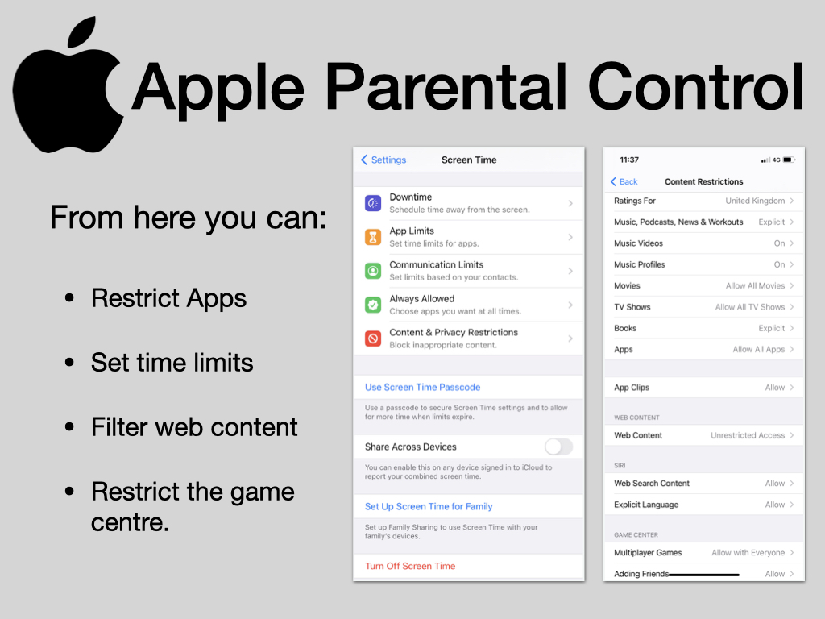

Slide 34
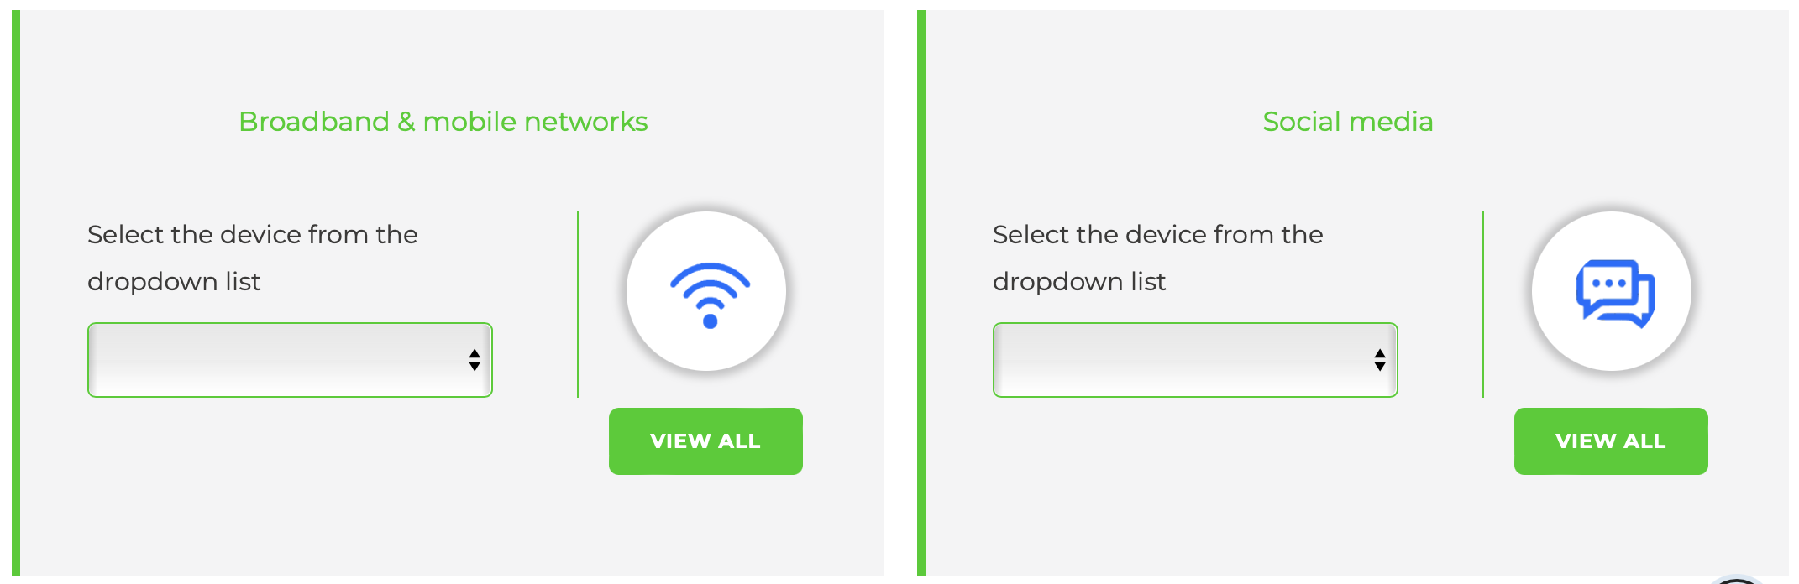
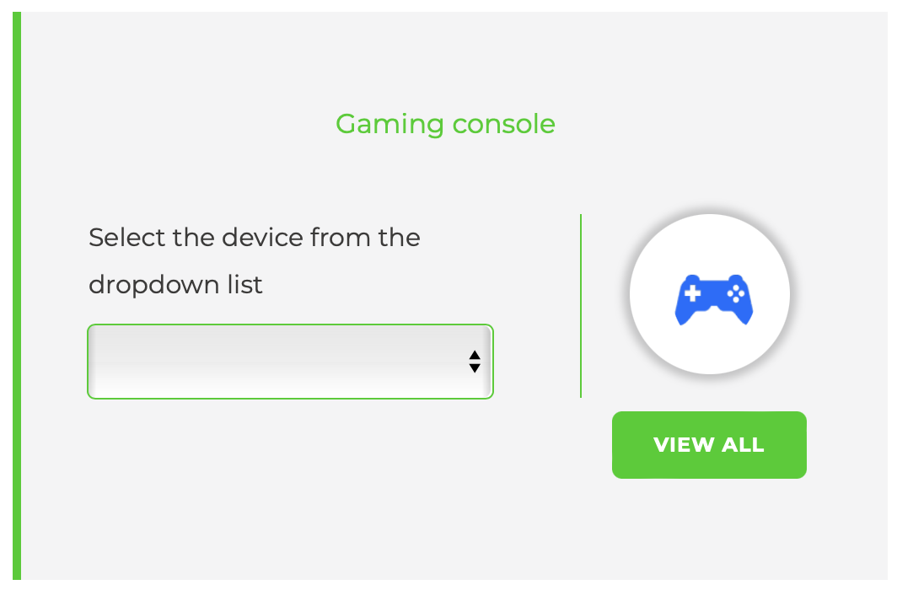
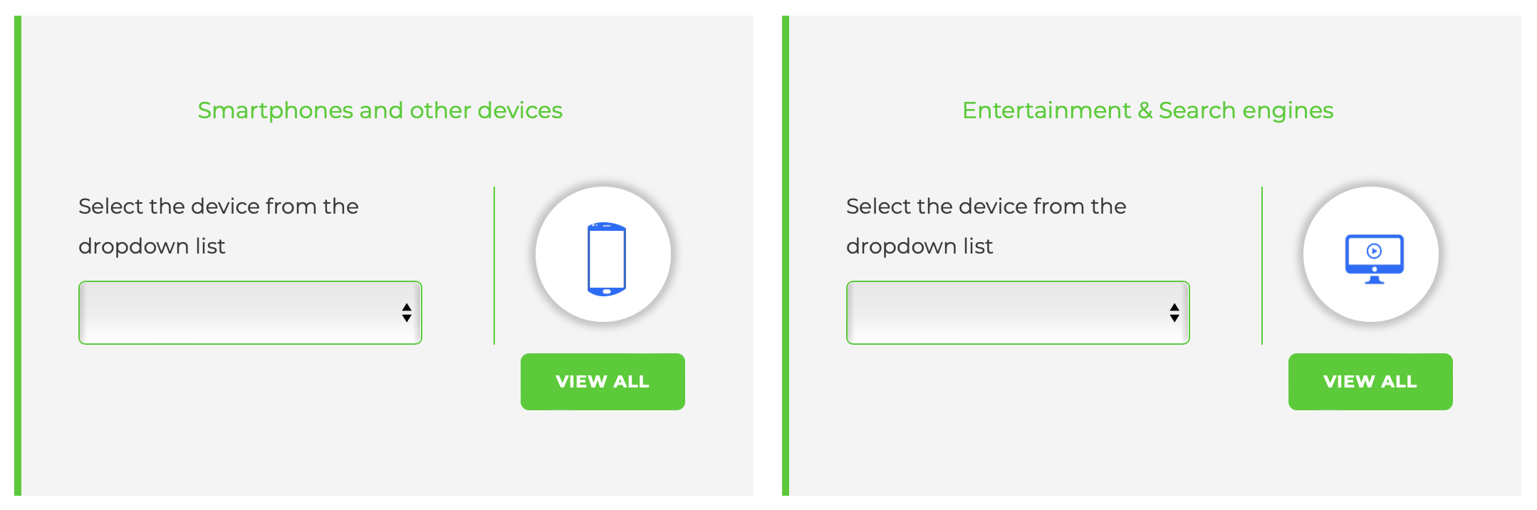
Internet matters also contains parental control guides for dozens of other devices including games consoles and smartphones
https://www.internetmatters.org/parental-controls

Slide 35
